Slide 1


DSA LAB I PRESENTATION
Presented by Kelvin, Uzoma and Dharambir

Slide 2



Core Functionality
- Add Students: Register new students with names and grades (maximum 10 students)
- View Students: Display all student records in a formatted table
- Delete Students: Remove student records by ID
- Grade Categorization: Automatic categorization based on performance levels
- Statistical Analysis: Calculate average, maximum, and minimum grades

Slide 3
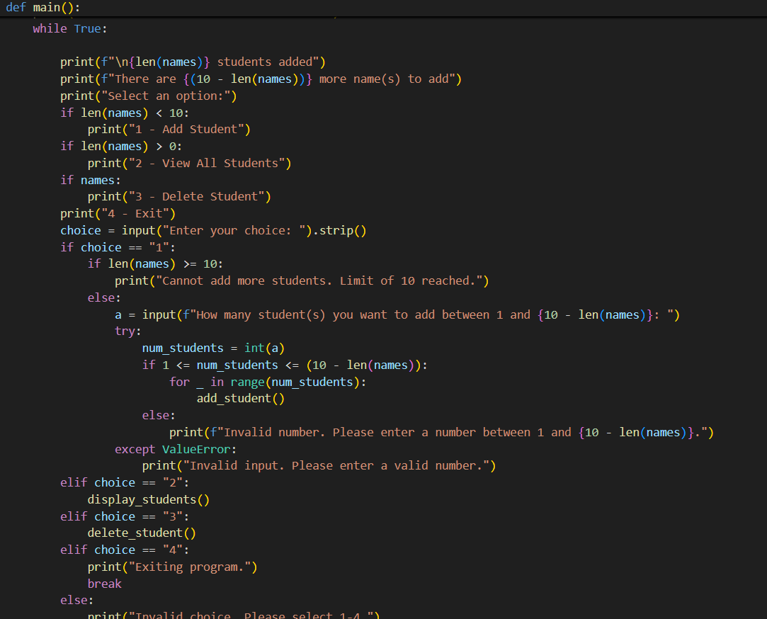
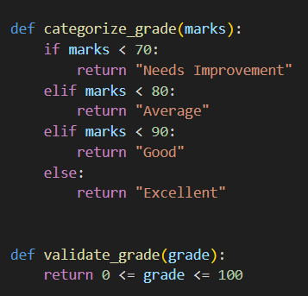
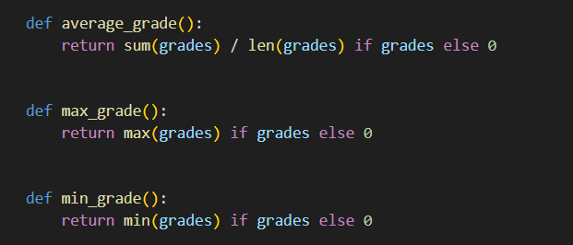
Dharambir
Grade validation and categorization logic
Statistical calculations

Slide 4
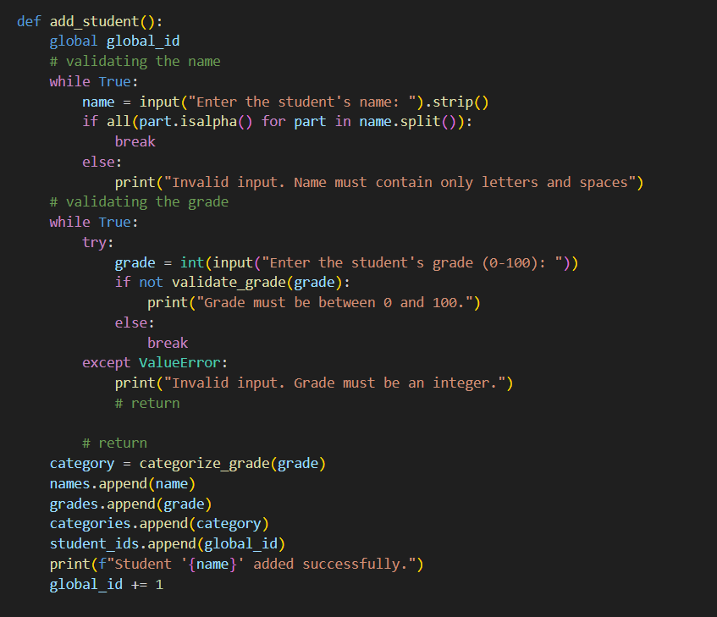
Uzoma
Student Management System
Data input functionality

Slide 5
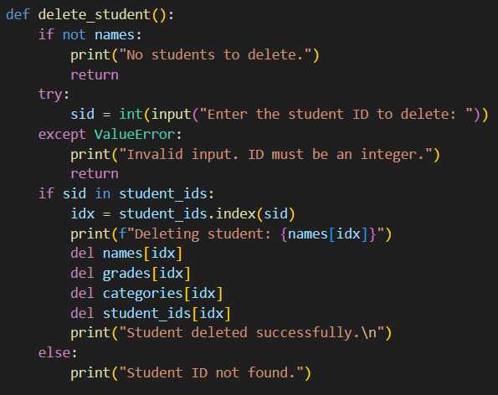
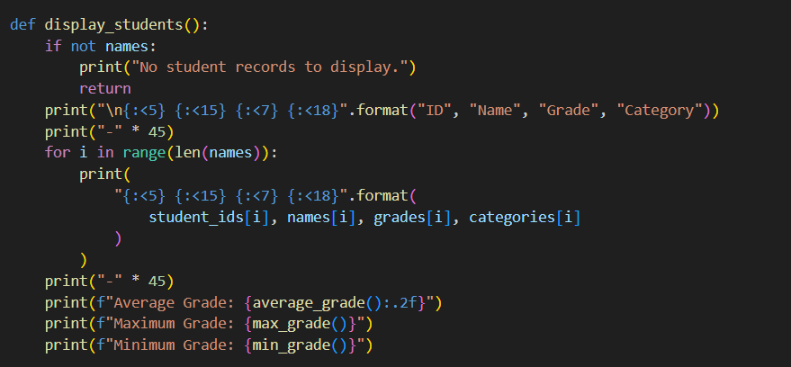
Kelvin
User interface
Data Display functionality

Slide 6
Challenges Faced:
We needed to remove the option to add after limit reached.
The user could not directly edit their name or grade without being prompted again
Our function accepted numerical input as name
Technical Fixes for Challenges:
Prevented adding students after the limit was reached: Added a check in the main() loop (if len(names) >= 10) to block adding more students and display a message.
Enabled direct editing of student names and grades: Modified the add_student() function to validate inputs and allow proper updates without repeated prompts.
Ensured names cannot contain numbers: Added input validation in add_student() using all(part.isalpha() for part in name.split()) to accept only letters and spaces.

Slide 7

Thank you!

